Slide 1

Multi-Touch Apps
The world at your fingertips Dr.ir. Erik Vullings & Drs. Arnoud de Jong

Slide 2
Introduction
Goal
“Simple and natural disclosure of information and sensor data to support decision making”
What we have
“A collection of reusable tools and components for interaction with information, multi-site collaboration and analysis.”

Slide 3
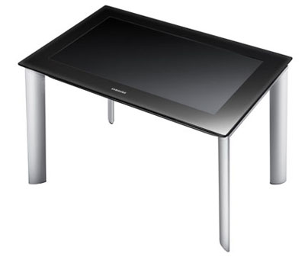
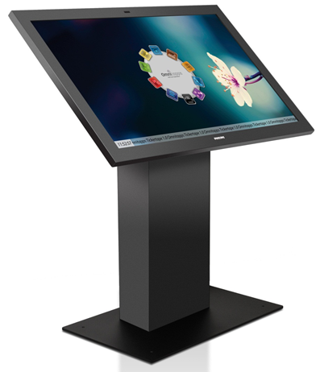
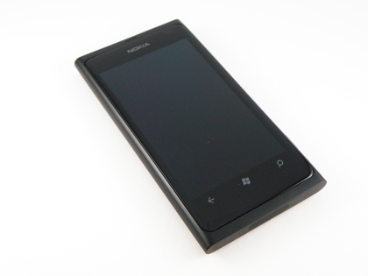
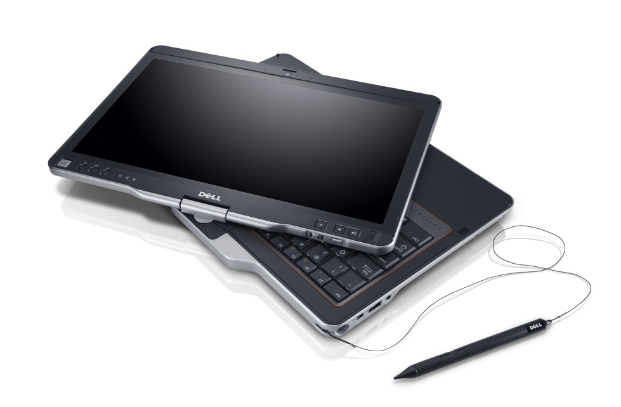
Devices
Surface 2 Samsung SUR40
Mobile Windows Phone Limited functionality
Tablets Win 7/8
Windows 7 Multi-touch API

Slide 4
Examples of applications

Slide 5
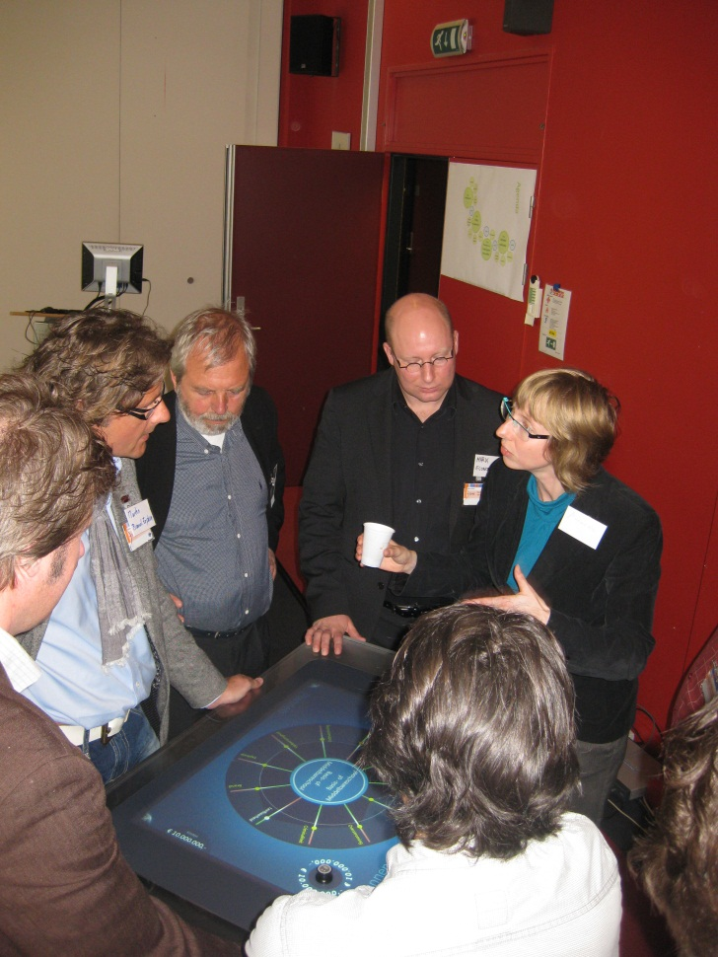
Innovative Urban Planning
Customer: City of The Hague
Goal: Enable domain experts to quickly and collaboratively create a master and safety plan for the city.
Experts estimate impact of plans and measures on the city collaboratively:
Criteria: Quality of life, Economics, Safety & Security and Costs
Combine selected plans & measures
Notes:
Image: Experts in different domains estimate the effect of plans and measures on selected clusters in The Hague. Since they estimate these effects collaboratively, they are able to immediately react to their colleagues estimates, which allows them to develop a shared expert model (much better than would have been obtained using Excel spreadsheets, for example).

Slide 6
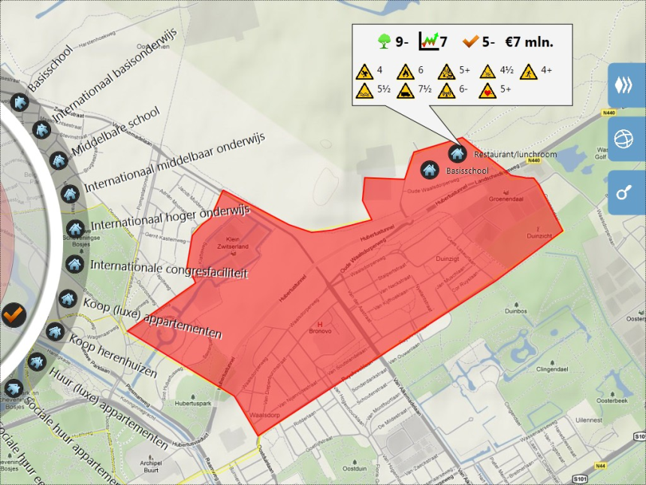
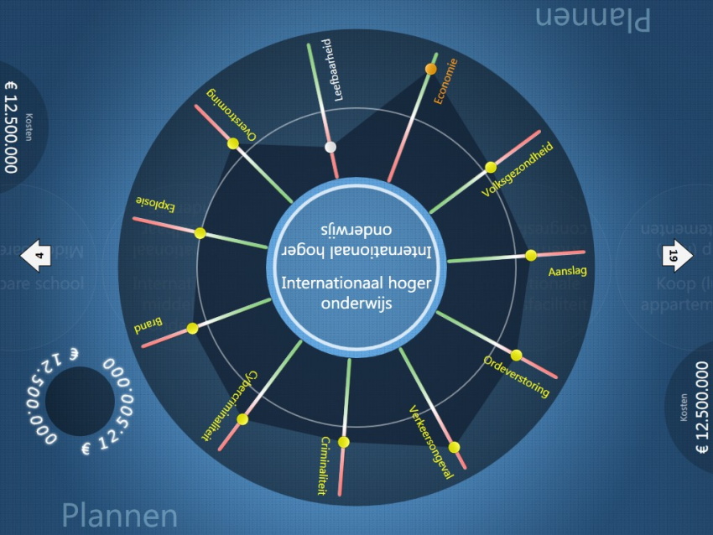
Drag plans (shown in the wheel) to a cluster on the map.
The dialog box instantly shows the effect on the criteria based on the expert model.
Domain experts collaboratively specify the effects of a potential plan (International Higher Education) on the area

Slide 7
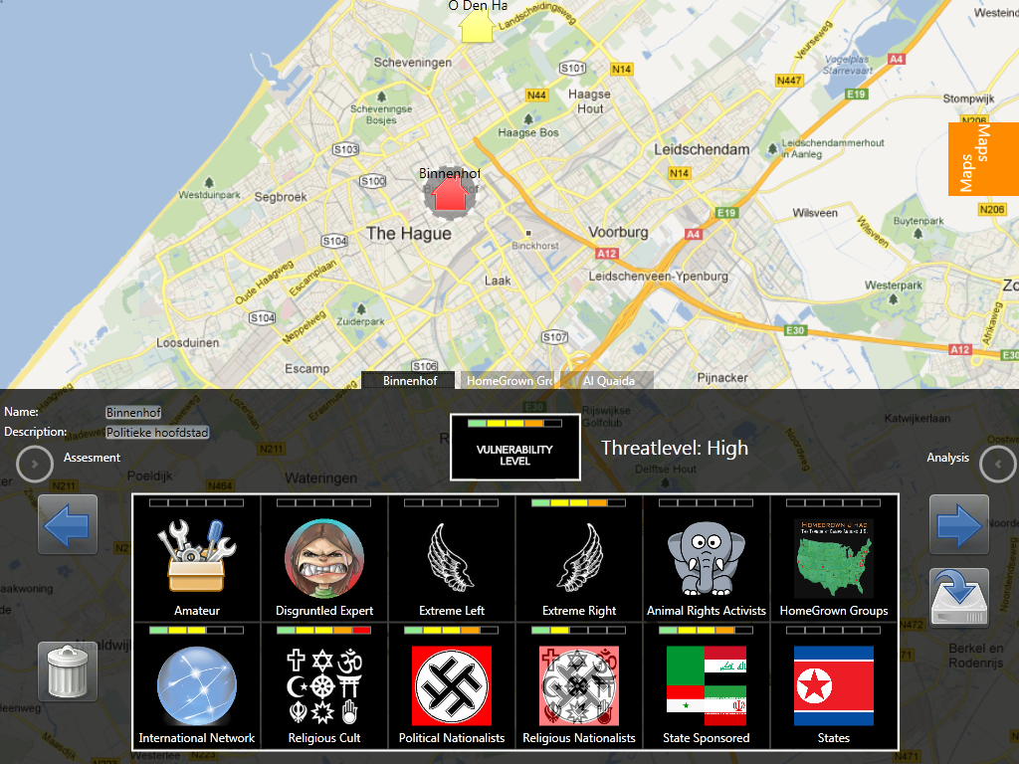
TerrorRisk
Goal Estimate current threat level per organization or building
Inputs
location vulnerability
terrorist sensitivity
terrorist activity level

Slide 8
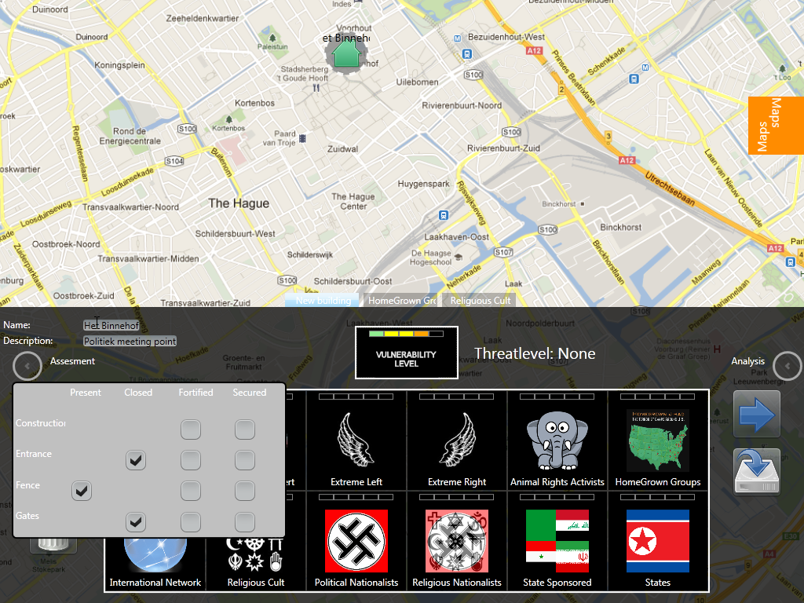
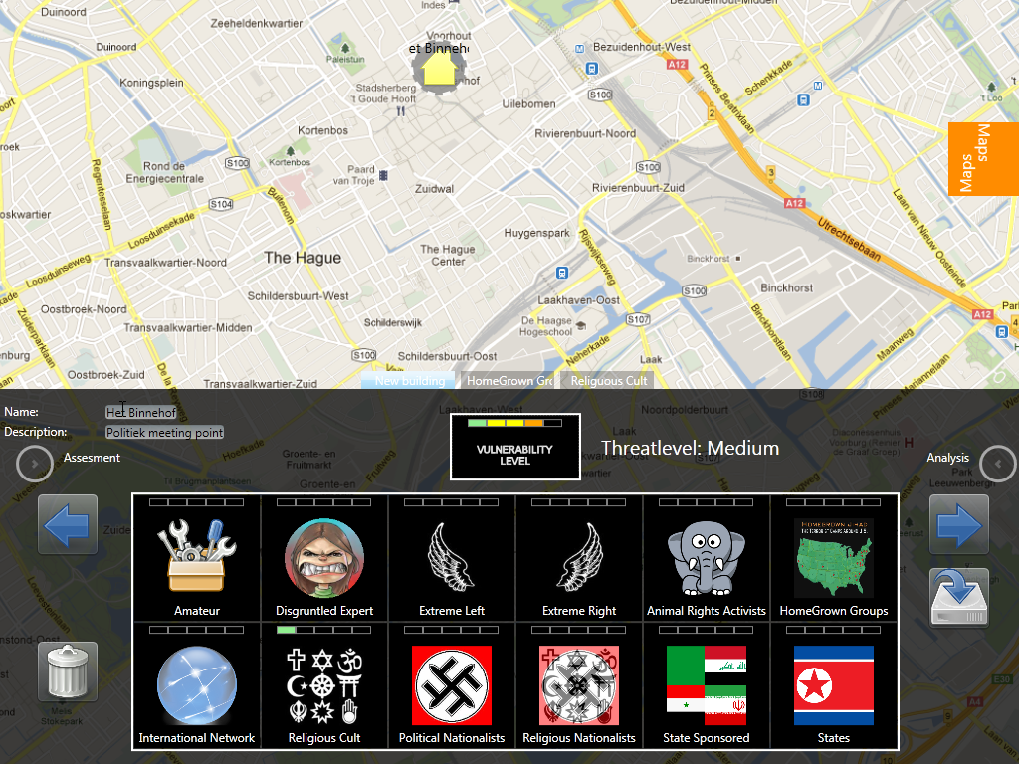
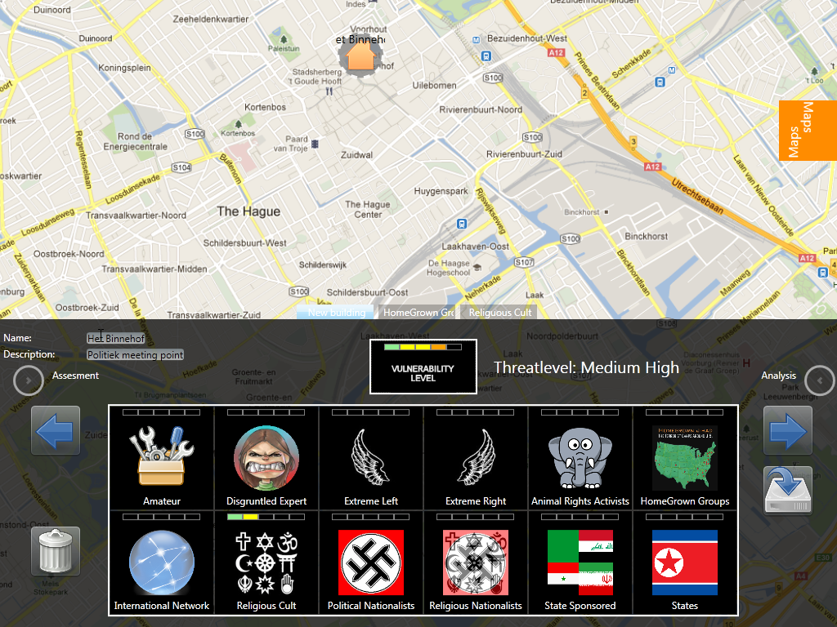
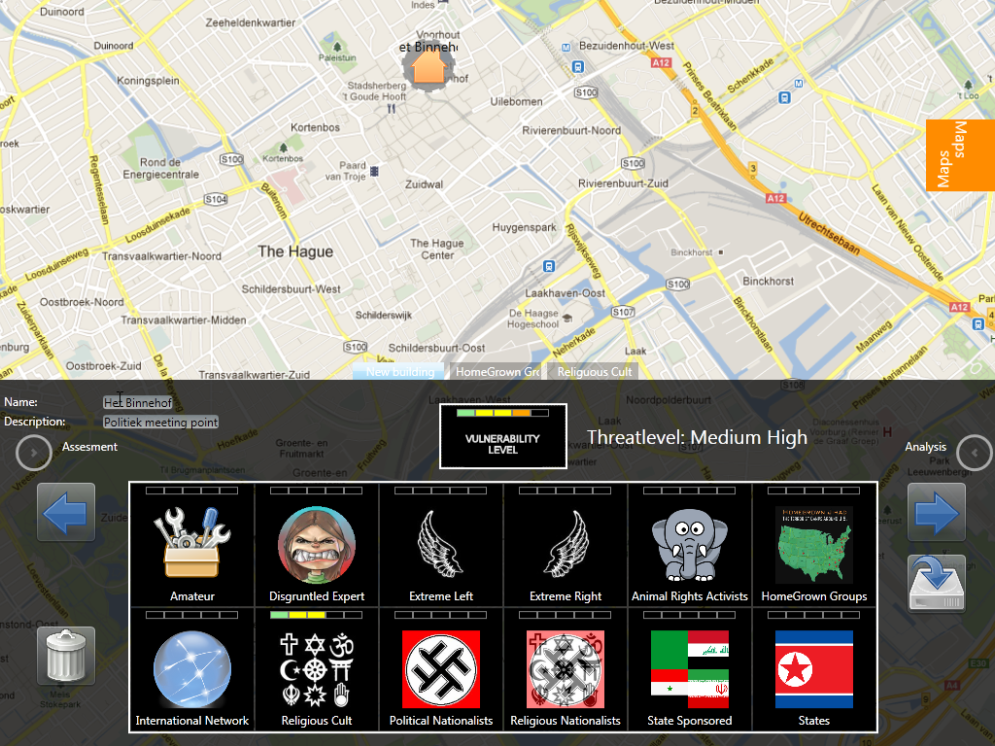
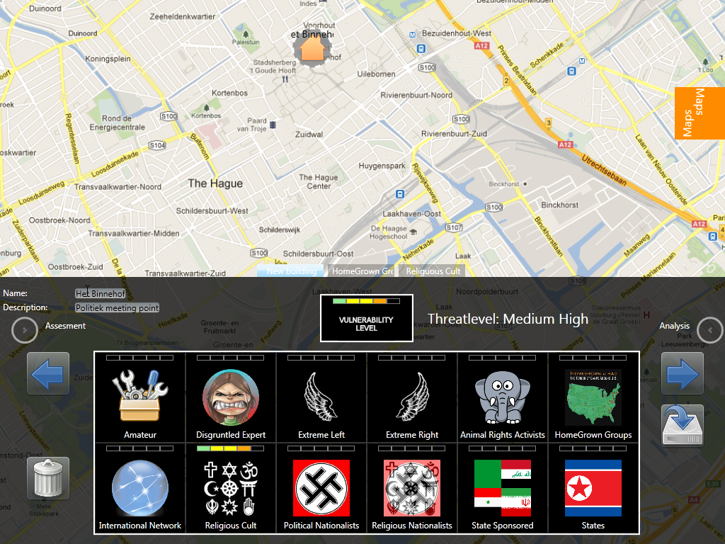

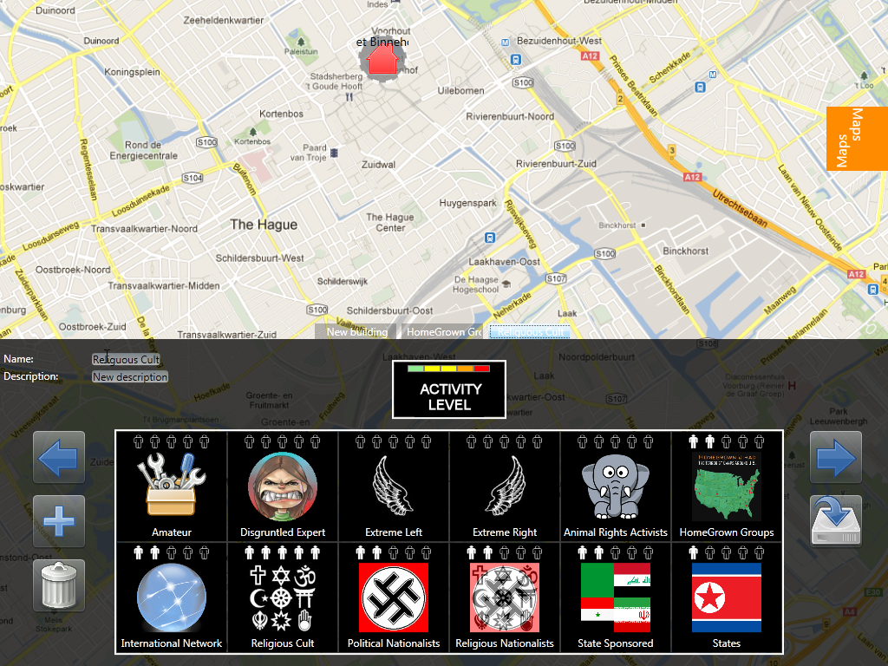

Slide 9
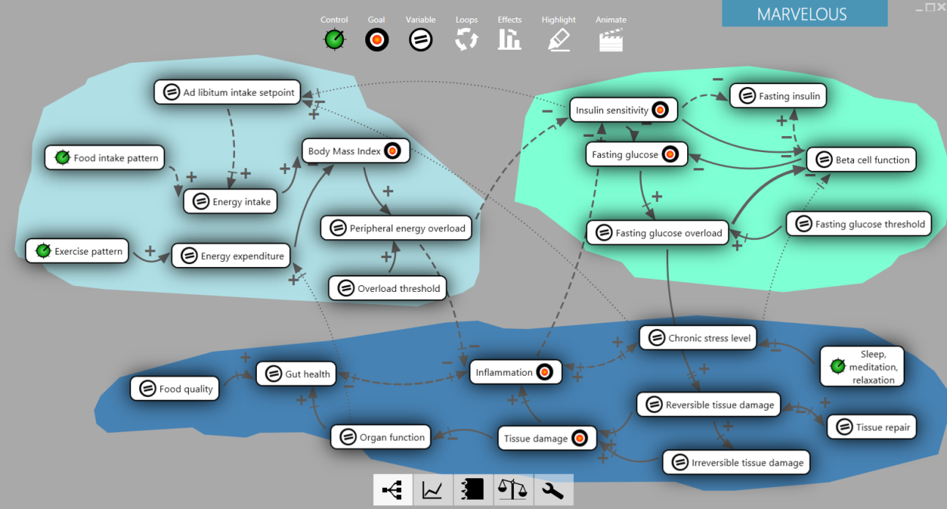
Marvel
Customer: Internal Business Consultants (Operational Research)
Goal: Develop Expert Models together with clients to estimate the effect of decisions
Based on casual loop diagrams, determine the strength of relations, sign and time delay between different domain concepts to determine the most appropriate course of action.
Notes:
See also: http://www.tno.nl/content.cfm?context=thema&content=markt_product&laag1=893&laag2=178&laag3=368&item_id=1249
Surface 2 application, which can also be run on Windows 7.
Green circles indicate control variables (ones you can change), red indicates goal variables, others are neutral.
Arrow thickness indicates strength of the relationship, and the small orthogonal stripes indicate delays.
Finally, the red lines depict the strongest loop.

Slide 10
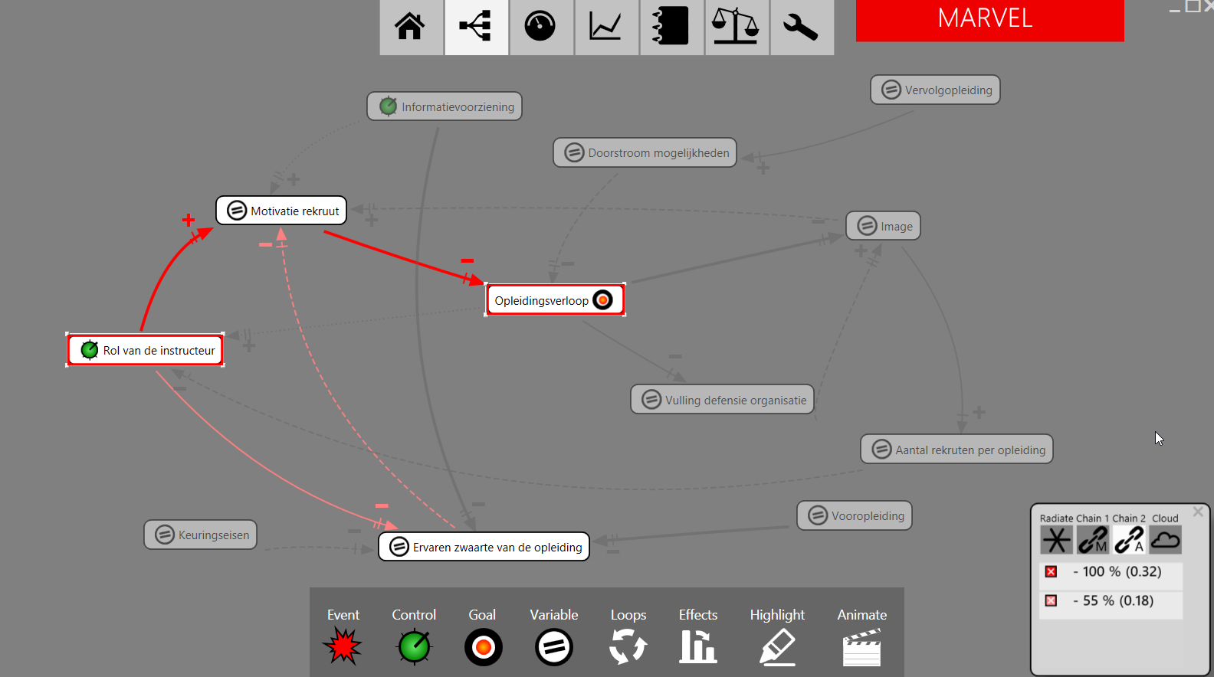
Influence Analysis in Marvel

Slide 11
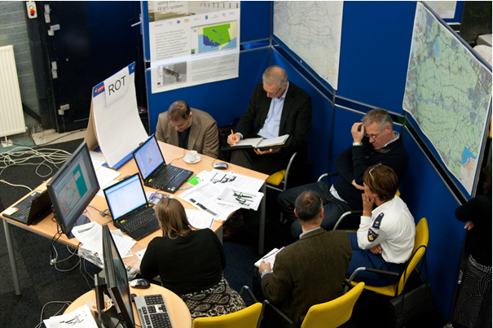
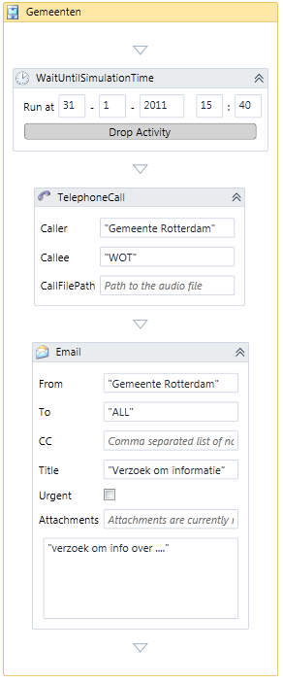
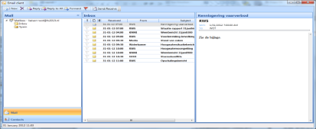
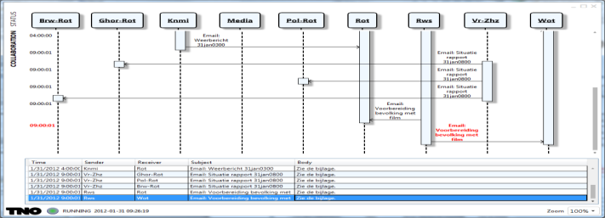
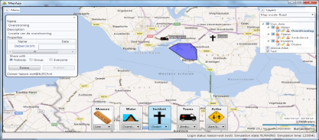
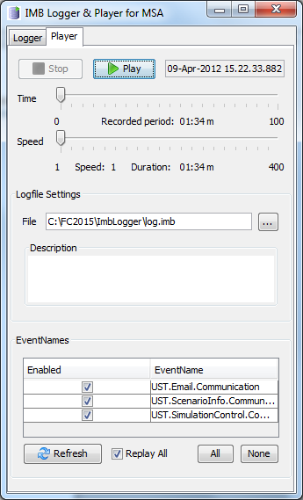
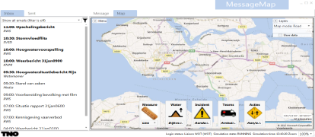
Crisis Management Training Suite
White cell sim
Email client
Visualizer
Map client
Logger & Replayer
Email+Map+Query client

Slide 12
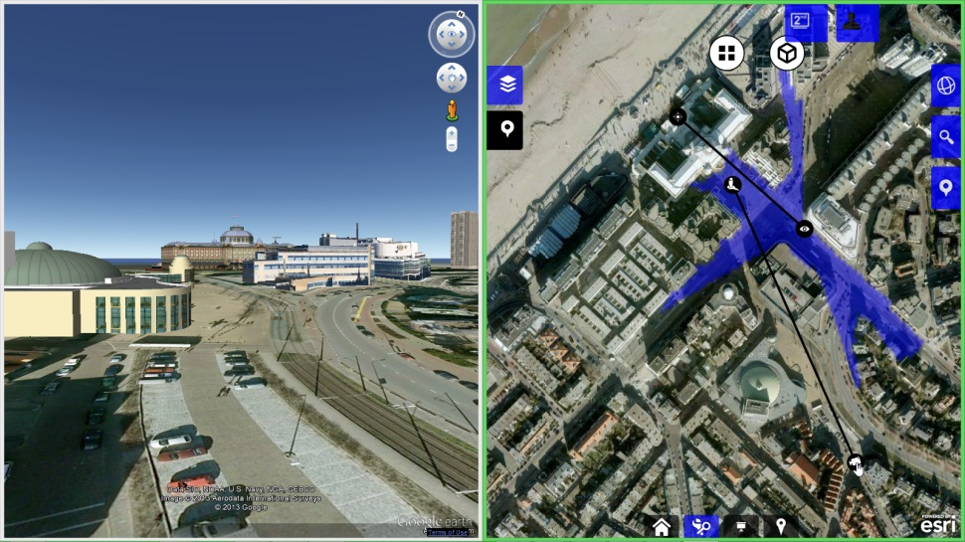
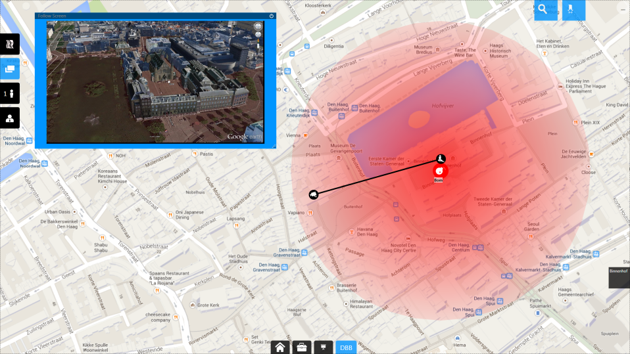
iTable
Customer: National Police (DBB = Service for Protecting People)
Goal: Increase the quality and effectiveness of security briefings.
Show location in Google Earth or StreetView
Analyse field-of-view at position
Mark (and collaboratively share) map with points of interest
Notes:
Top left) Google Earth view from camera,
Top Right) Field of view from location
Bottom: Mark and share map

Slide 13
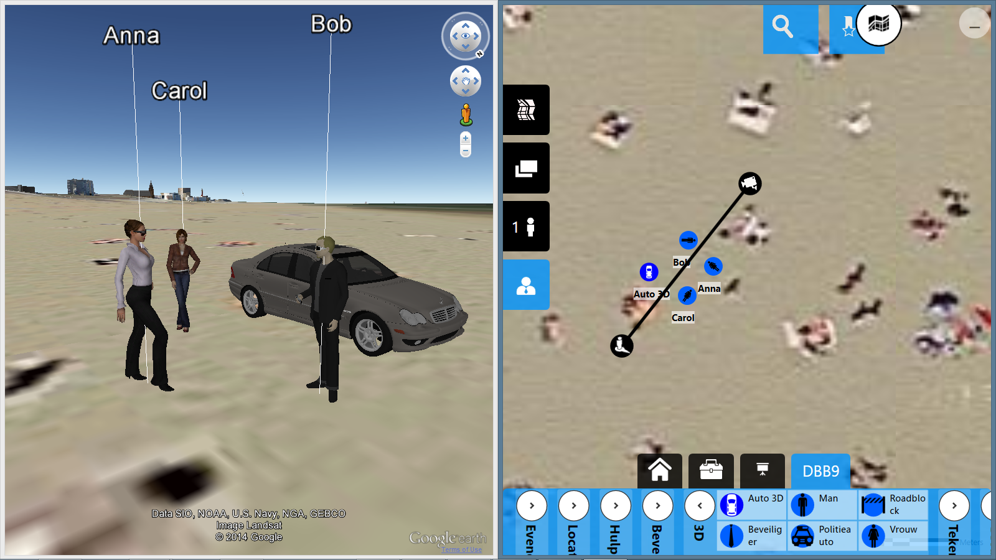
Combine top view with 3D view in Google Earth

Slide 14
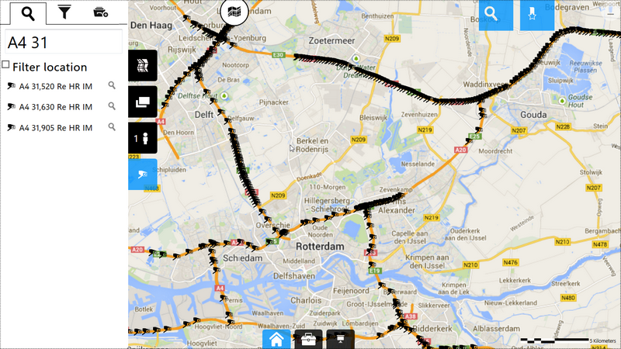
Access traffic cameras

Slide 15
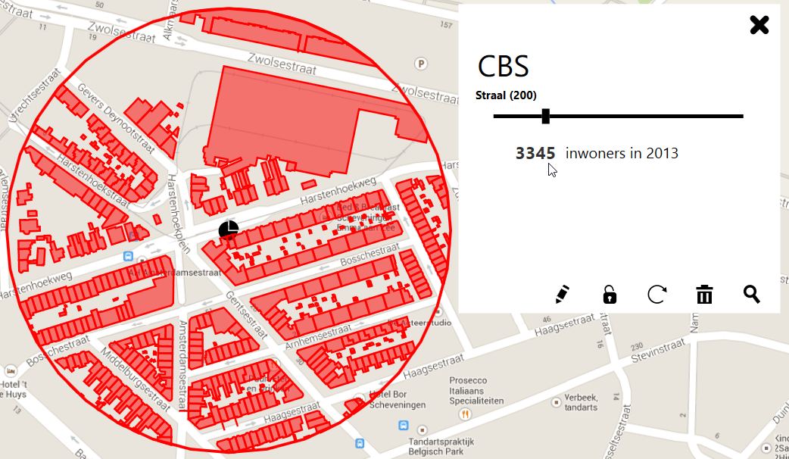
Extract situational information from databases

Slide 16
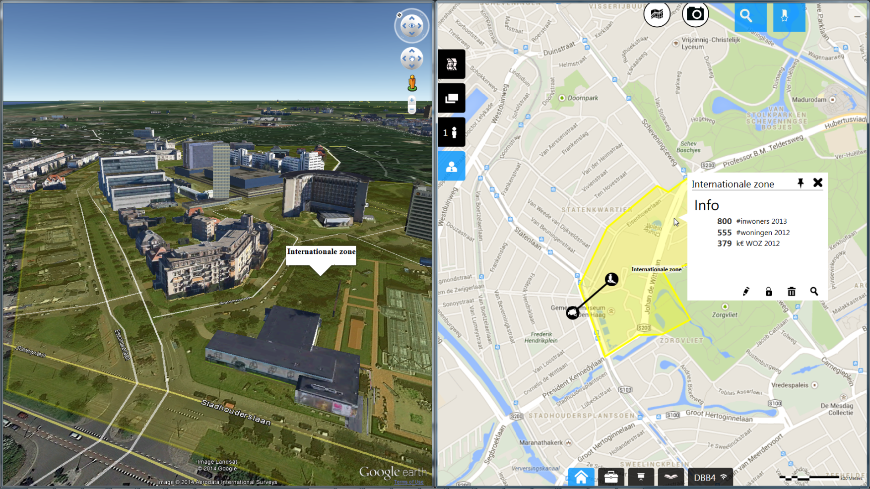
Combine 3D information with CBS statistics

Slide 17
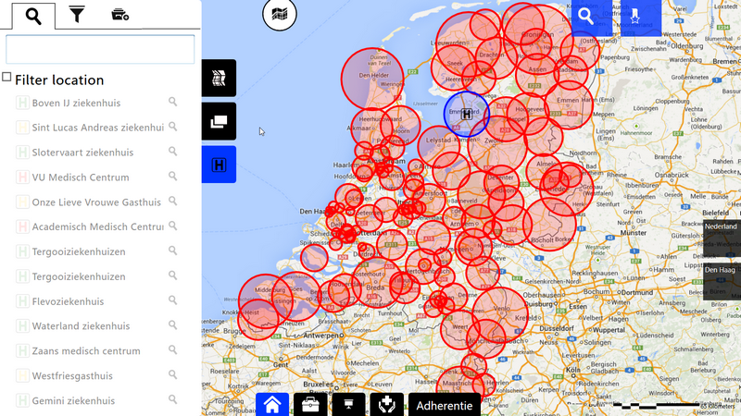
Filter information by location

Slide 18
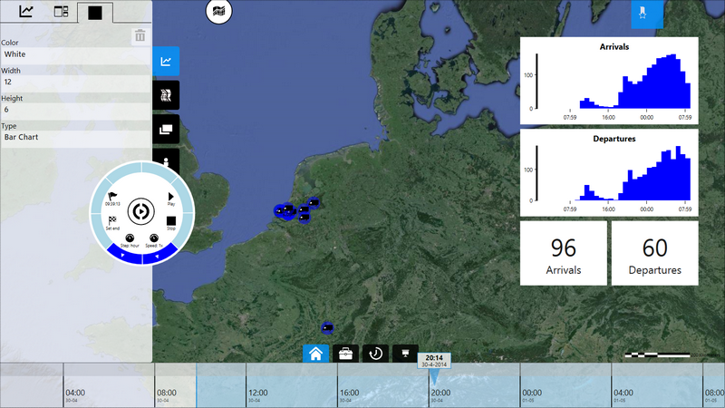
Visualise information streams or run simulations

Slide 19
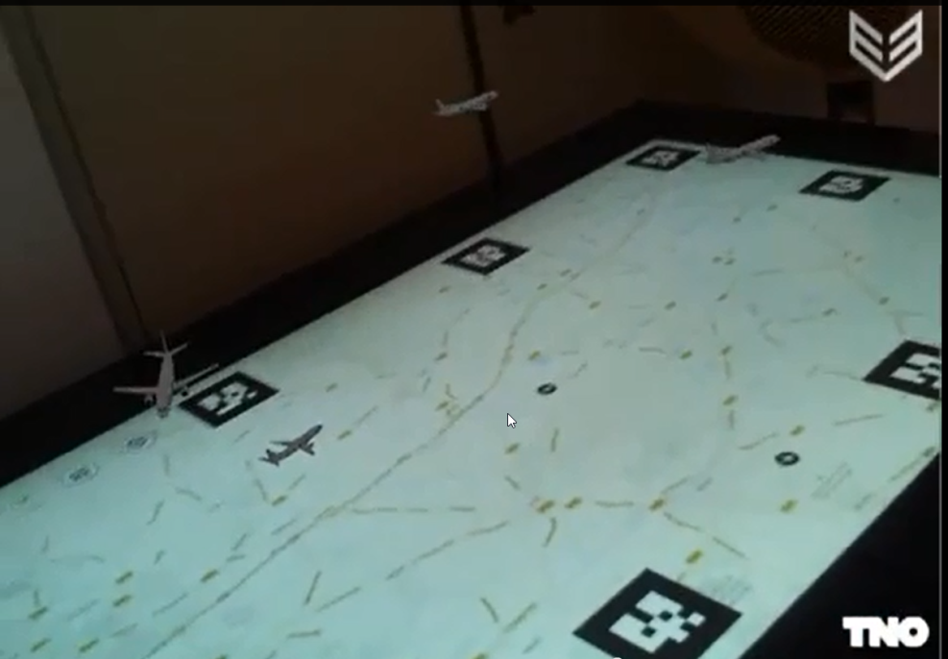
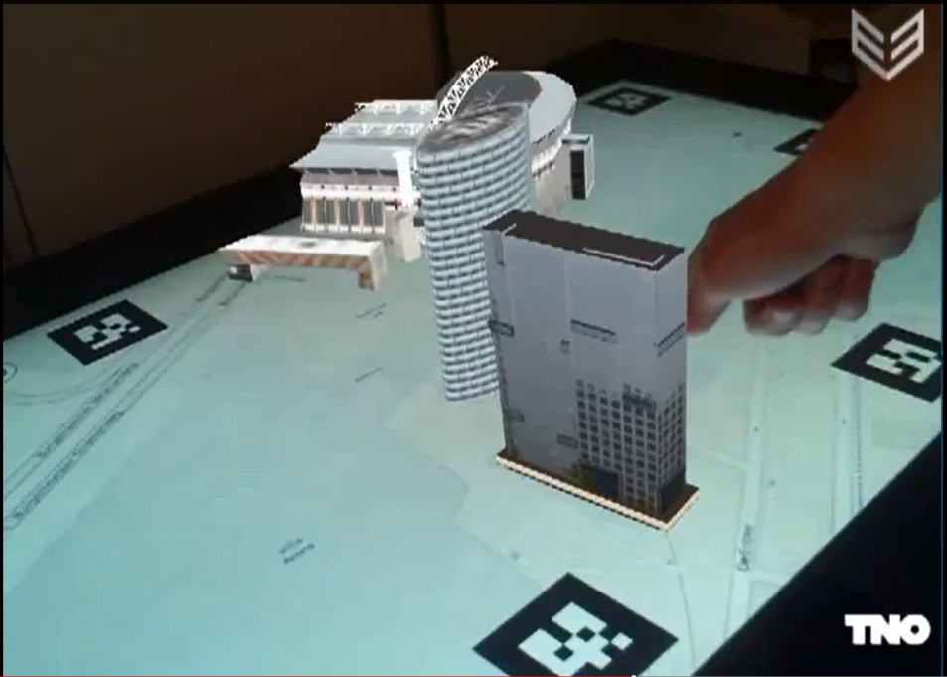
Augmented Reality for 3D Situational Awareness
Experimentally, we added augmented reality markers to the map, so we can inspect the situation in 3D too
Left) Real-time flight tracker service
Right) Amsterdam arena
http://www.youtube.com/watch?v=bsiHB8AxpqQ&feature=youtu.be
http://www.youtube.com/watch?v=zhnKipiUCJQ&feature=youtu.be

Slide 20
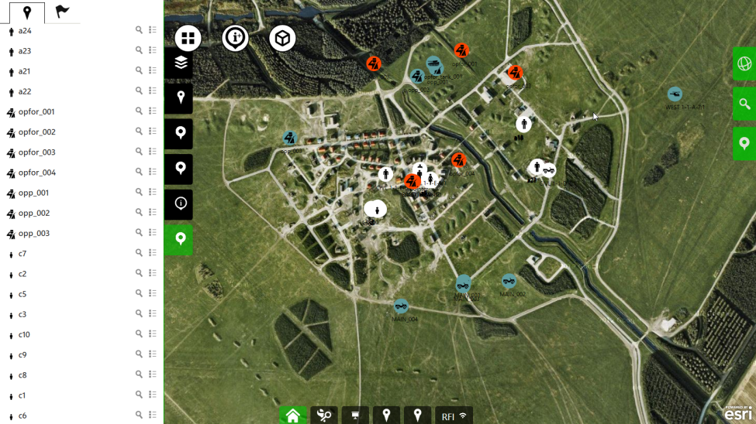
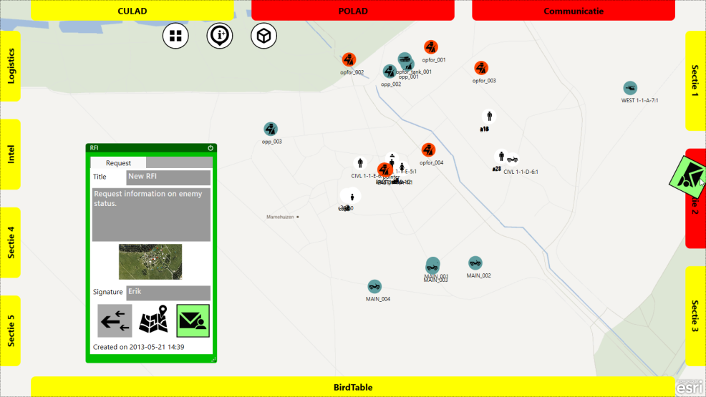
TouchMii
Customer: Command and Control (C2) birdtable, Ministry of Defence
Goal: Increase the quality of strategic and tactical decisions
Interfaces with VBS2, the serious game used for training, to show the units on a map.
Decision support for commanders
Facilitates interaction with the second line.
http://youtu.be/Ix2vhcecapo
http://www.youtube.com/watch?v=O9H1f0FcHNs
VBS2 units on the map
Send request for information to 2nd line

Slide 21
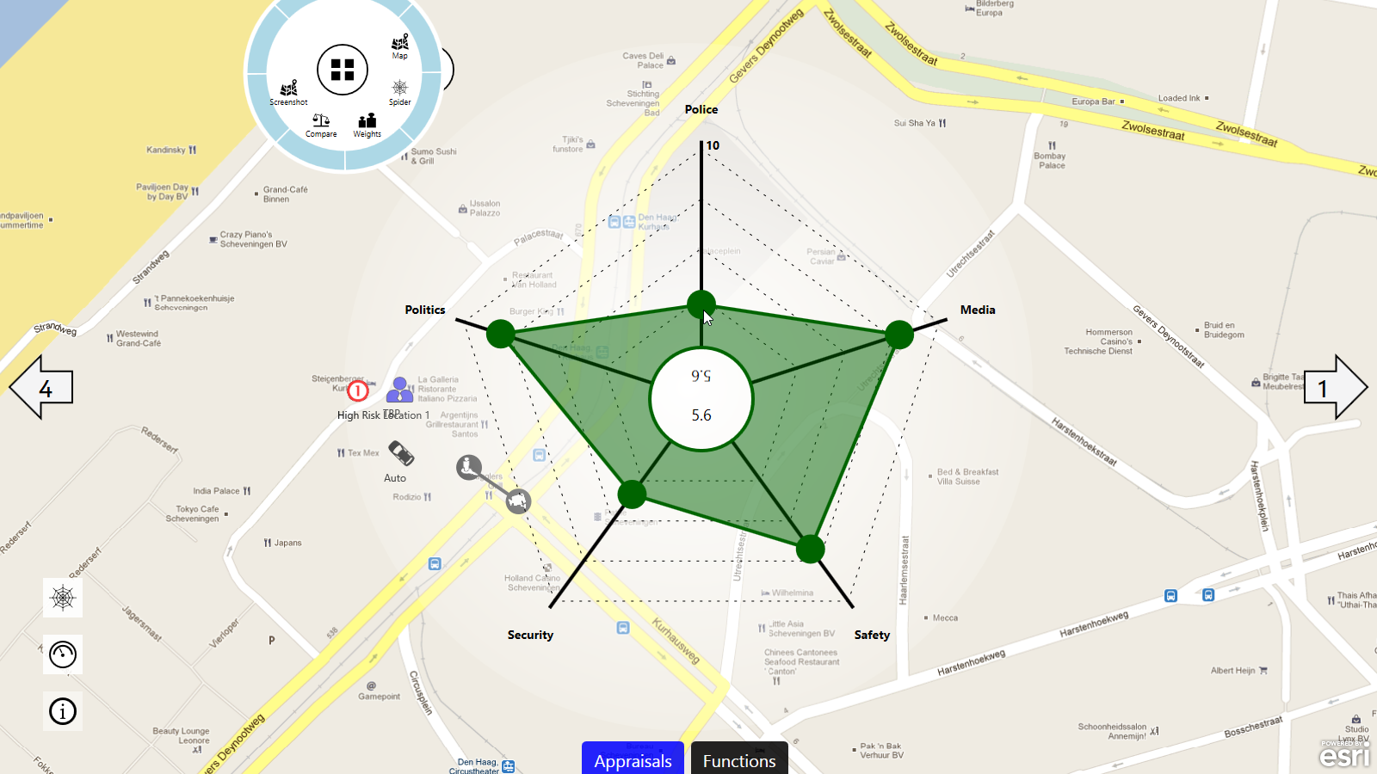
Decision support: Analyse & discuss alternatives

Slide 22
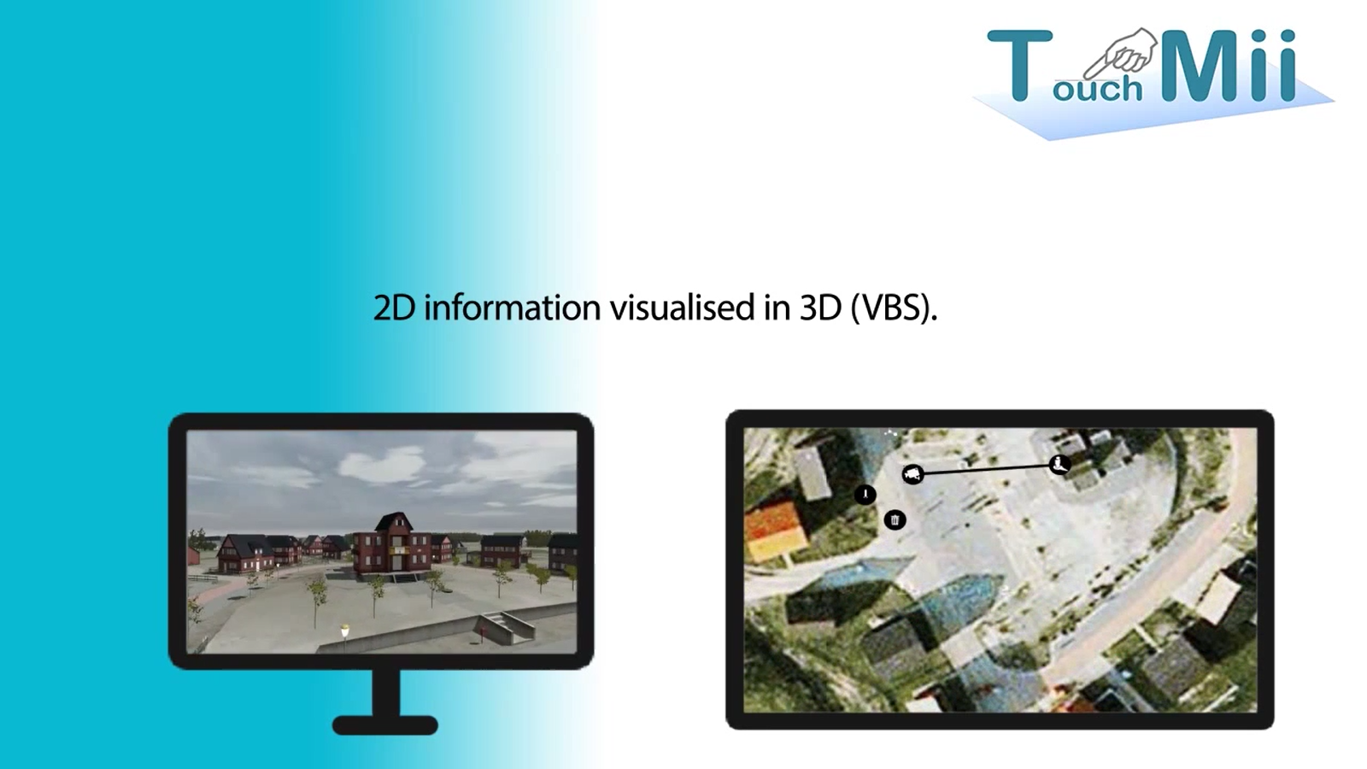
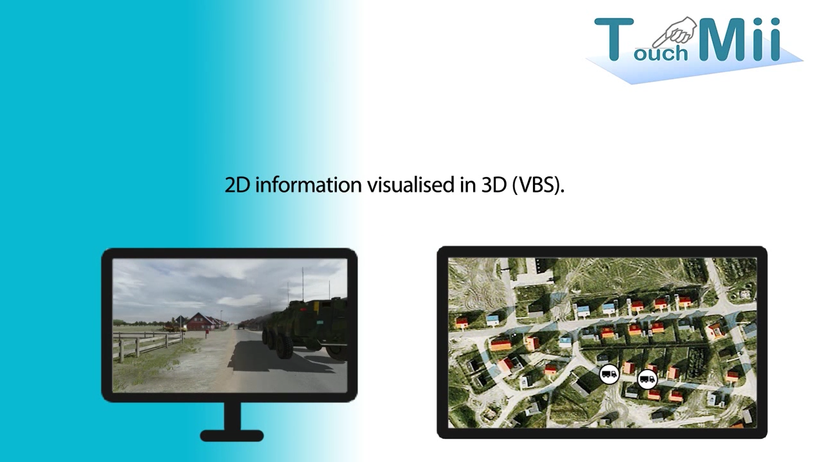
Situational Awareness in VBS2
simcenland@mindef.nl

Slide 23
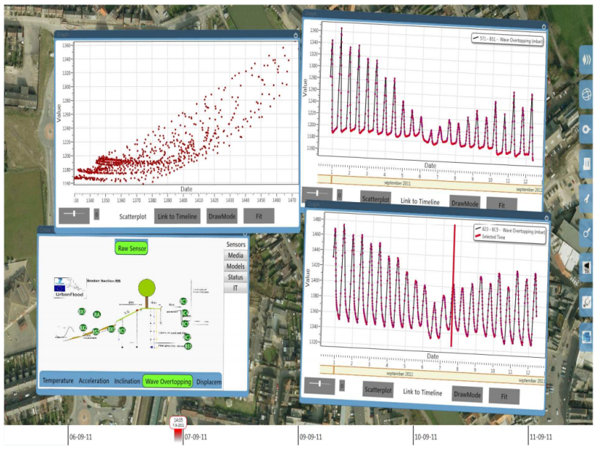
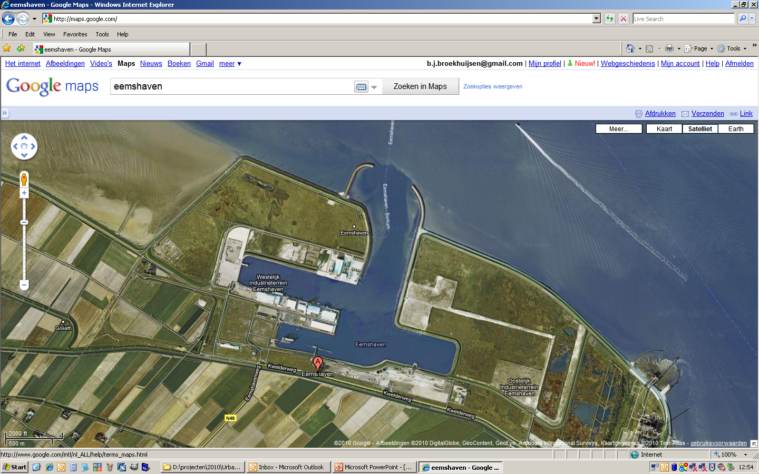
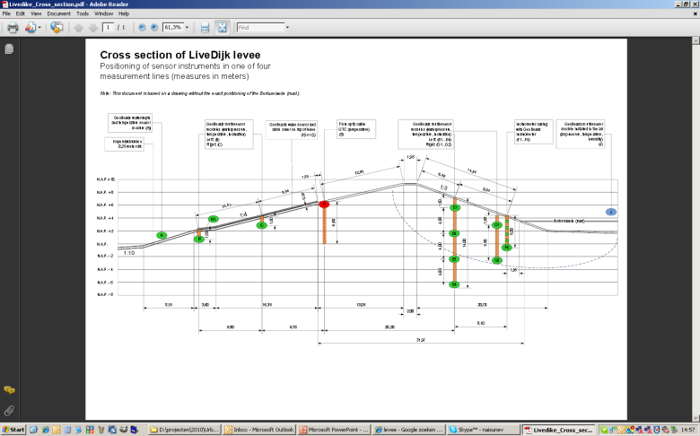
UrbanFlood (FP7)
Customer: Framework Program 7
Goal: Develop a Surface platform for sensor management during daily operations but also during flooding.
Alert Level
Severe
High
Elevated
Guarded
Dike Cross Section 2
Guarded
Low
Waterheight
Sensor
AI
Rel
Flood
4D
Notes:
Also note the timeline (top right image) at the bottom of the screen. It allows you to quickly review the past or predict (using models) the future.
UrbanFlood on YouTube:
- http://www.youtube.com/watch?v=z4Gl4L26o_Y
- http://www.youtube.com/watch?v=w48Op4TF26U
- http://www.youtube.com/embed/PRHbs46Gtxo
Website Urban Flood:
- http://www.urbanflood.eu

Slide 24
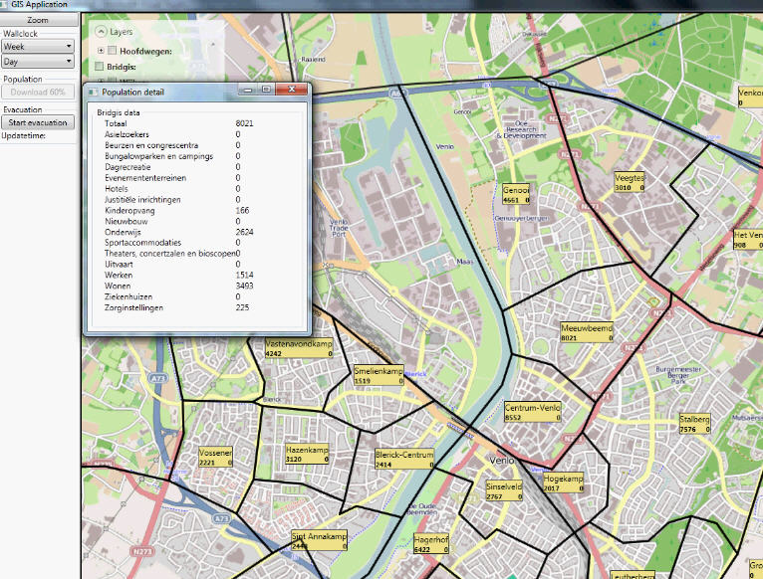
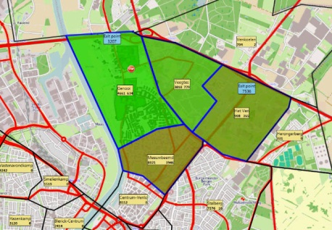
The Reality Check: Real-time Evacuation Model
Increased situation awareness during a crisis
Takes population types into account

Slide 25
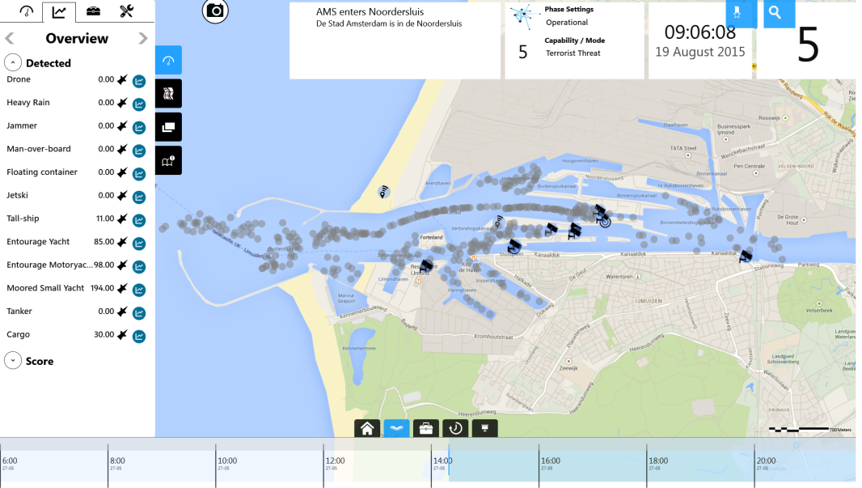
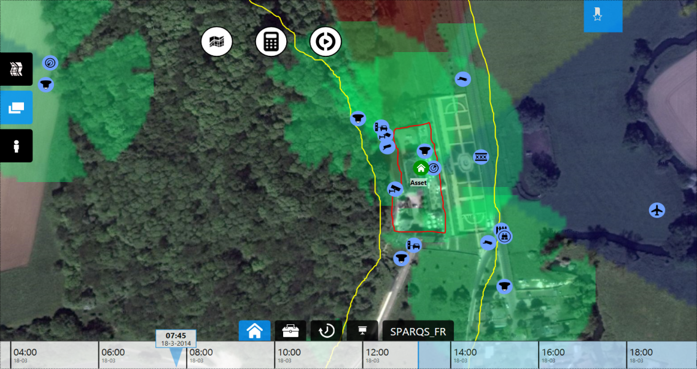

SPARQS (Sensor Planning, Allocation of Resources and Quality of Service)
Customer: STARS project
Goal: a tool for sensor planning: drag-’n-drop sensors, configure them, analyse field of view. Is used to establish roadmap using CDAG (Concept Development Assessment Game): determine most important sensor features
Using Resource Allocation Algorithms (Matlab)
SAIL2015
Neercannes

Slide 26
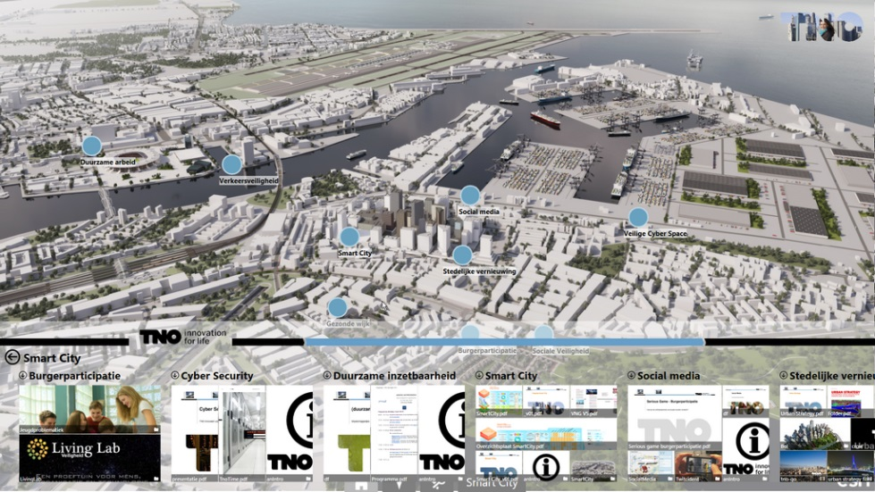
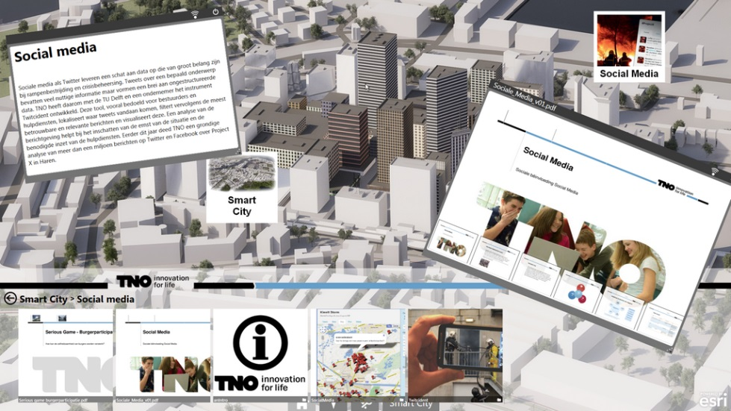
TnoPresenter
A multimedia presentation tool to interactively show content.
Customer: Communications dept.
Goal: present TNO’s knowledge, product and project portfolio in an interactive way.

Slide 27
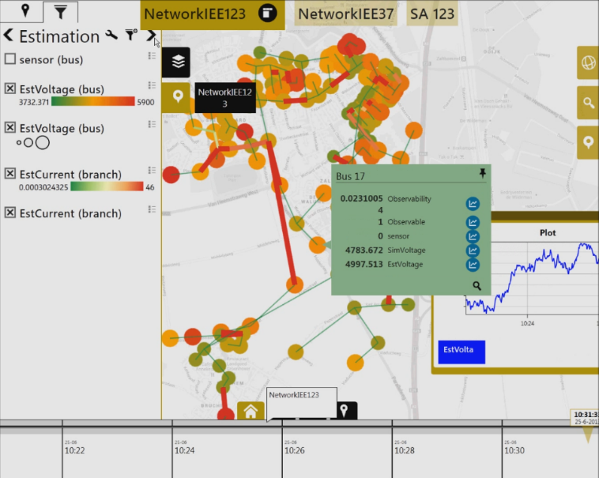
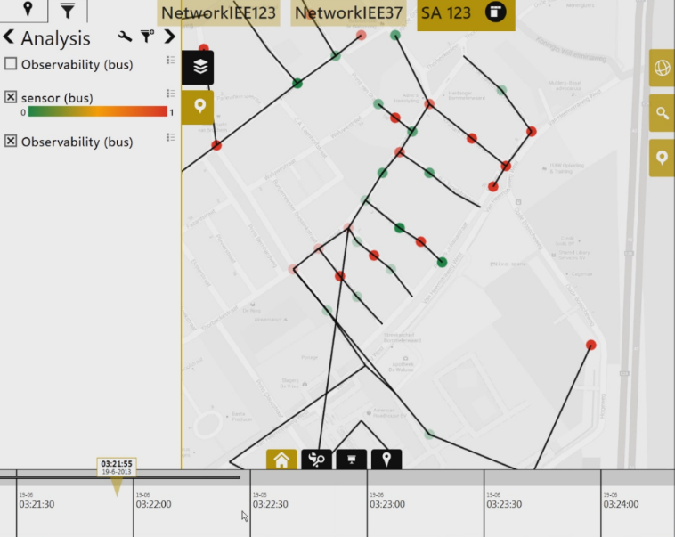
ieNat
Provide a virtual infrastructure to large scale electric grids:
Enables Energy Services by collecting and analysing data from the physical Infrastructure
Matlab back-end with load flow solver, State estimation, Data aggregation & sensor placement algorithms

Slide 28
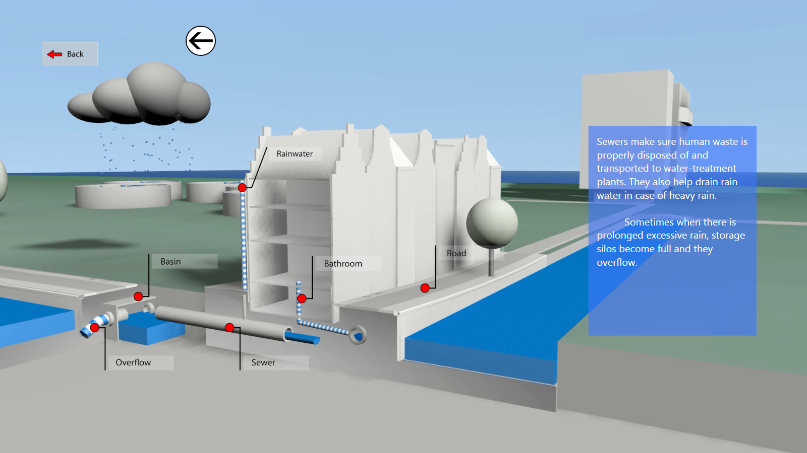



EIT Waternet
Full Water Cycle demonstration
3D animations for explanations
Real-life data for investigations (vessel tracking, dike monitoring, waterway sensors, bridges, sewers, etc.)

Slide 29

CareTool
Customer: Ministery of Health (VWS)
Goal: Gain insight in the position of long term health facilities

Slide 30



Common Sense – for defence
Common Sense is an integrated C4I demonstrator consisting of:
a smartphone application for dismounted soldiers
a command post application on a multi-touch table, tablet or smartphone
Features include blue force tracking, drawing, changing and sending waypoints, marking areas or points of interest, (push-to-talk) speech, voice messages, chat, sensing photos, event logging, task lists and context-dependent information transfer

Slide 31

Logistic Planning
Customer: Logistic company
Goal: Develop an intuitive dashboard for planning ship allocation

Slide 32

SafeMe
Tool to compare the risk reducing effects of safety measures.
Uses open source data (CBS, BAG, risicokaart.nl) with different computational models to compute effects of risk reducing measures.

Slide 33

Maritime Situational Awareness
Customer: Ministry of Defence (Royal Navy)
Goal: Determine the most effective course of action to intercept pirates, smugglers and illegal fishers.

Slide 34


SECURED Security Reqts. Editor & Designer
Customer: FP7
Goal: Facilitate the creation of security scenarios, requirements and design secure transportation hubs such as train stations and airports.

Slide 35

The Missing Link
Customer: Ministry of Defence
Goal: Web application aimed to decrease the gap between operational needs (scenarios) and potential solutions (ideas of systems)

Slide 36
Technical background

Slide 37




















System Architecture
Publish/Subscribe Enterprise Bus
3D
Visuals
…
Public Internet (+ authN/authZ)
Models
2D Editor
Sensor
Apps
Actuator
Apps
…
Web services
Sensors
Actuators
Rich
Internet
App.
…
Notes:
System Architecture of our applications: The Microsoft Surface touch table interacts with externally hosted models and web services. The Enterprise Service bus has client connectors for most popular programming languages (C# including Silverlight, C++, Java, Delphi, Flash) and Operating Systems (Windows, Windows Phone, Android, iPhone and iPad), allowing the Surface services and decisions to be shared with persons, sensors and actuators.

Slide 38


Basic building blocks
Map component (ESRI) Base layers: Google, Bing, Yahoo, ESRI, OSM.... WMS layers: Buienradar, BAG, PDOK, Panoramio… PostGIS layers: Based on an SQL query
Bookmarks and Dashboards To return to locations easily, including selected layers.
Multi-touch interaction Support for (multi-)touch as well as mouse interaction on Windows 7 & 8.
Modularity Every application is modular. Using a plugin structure, new tools, map layers, models etc. can be added.

Slide 39



Basic building blocks 2
Points of interest layers Create your own layer definitions in XML
Time-based events Similar to timeline.js, visualise events on the timeline.
Presentation of content Show media in a folder structure, push to SecondScreen, share with QR code. Can be linked to a PoI, e.g. floor plans.

Slide 40


Interfacing with external applications
Plugins control Turn plugins on/off. Dynamically load new plugins. Start other programs.
Interact with other apps
Either based on the CommonSense framework, or by interacting with the IMB bus, e.g. SecondScreen (Google Earth wrapper), EVE/Havok, ScreenCappy… Sims: VBS2, JROADS

Slide 41




Analysis tools
Timeline & player Interactive timeline interface for navigating through time. Sensor data is updated based on focus time.
Graphs Visualisation of sensor data using interactive graphs that can be annotated.
Map tools
Drawing and annotating on the map, (reverse) geo-referencing, determining distances or field-of-view, routing (for cars and walking)

Slide 42



Analysis tools (2)
Multi-Criteria Analysis, easy filtering and highlighting
A PoI can be filtered/colored based on static or dynamic properties: style can be manually set or specified in XML.
Intelligent Points of Interest
A PoI can be enhanced with its own code, e.g. to draw a zone, show a field-of-view, animation…
Extensive search capabilities
Query Google Places, DBPedia, and more, and add the results to the map.

Slide 43
Collaboration and Co-design
Real-time Remote Viewing See who is online, share your view, map and timeline synchronization, sharing of photo’s, video’s, map layers.
Remote Editing
Share and annotate collaboratively.
Working together
Chat with co-workers, teleconferencing, email, chat (voxer), twitter…

Slide 44
System Management module
Web-based configuration Application developers can configure an application via the web. Online logging of usage statistics and bugs.
Installation and updates Can be done automatically (via Click-once)

Slide 45


Interface with models and simulations
Existing models
Traffic management, Noise management, air quality, quality of life, ground water, durability, external safety, costs, impact of explosions, Building Information Models, Field of View…
Existing simulations
Marine traffic, weather and wind, flooding, evacuation, oil spills, traffic jams, intelligent traffic systems…

Slide 46




Coupling with external devices
SecondScreen Google Earth, StreetView, photo’s, timeline, video, websites, presentations
Gestures & voice interaction Using Kinect to control applications via voice or gesture
SmartPhone Exchange live GPS position (blue force tracking), media, live streaming of camera image

Slide 47


And many more …
CCTV integration
Interfacing with simulation standards such as DIS and HLA
Active tangibles
Social Media integration
Live TV streams
VNC coupling
Conference call / SMS
TV / CCTV video stream
Impact of explosion

